Slide 1

DeepTrim: An automated platform-aware domain customized framework for Deep Learning
Progress Report
Prof. Farinaz Koushanfar
May 2018

Slide 2
Deep Learning
Achieved superior inference than traditional machine learning methodologies
Notes:
Deep Learning methodologies are becoming popular
Have achieved superior inference for several field
beyond traditional linear or polynomial analytical machine learning

Slide 3
Deep Learning on Resource Constrained Devices
High computational overhead limits Deep Learning’s performance in resource-constrained settings
Notes:
High computational overhead limits DL’s performance in resource-constrained settings

Slide 4
Tensor Decomposition for DL Parameters
Decompose static element to improve inference efficiency
Kernel tensors for convolutional layers
Weight matrices for dense layers
Matrix decomposition: Singular Value Decomposition
Tensor decomposition: Tucker Decomposition vs. CP Decomposition
Notes:
Trained model are significantly redundant
Once the model is trained, redundancy can be removed to improve inference efficiency
Computation and storage costs of CNN are dominated by conv and dense layers, respectively
Decompose conv kernels and fully-connected weight matrices to optimize computation and storage

Slide 5
Singular Value Decomposition (SVD)
U and V are orthogonal matrices
Σ is diagonal matrix with nonnegative entries, and with the diagonal entries sorted from high to low
Notes:
- The diagonal values in Σ correspond to each left/right singular value for U and V
- Reduce each of those matrices correspondingly to r (rank)
- preserves the r most important linear combinations of sets of vectors

Slide 6
Tensor Decompositions
CP Decomposition | Tucker Decomposition
Slightly Better decomposition result^{[1]} | Good decomposition result^{[2]}
In-stable when more than 1 layer is decomposed together^{[1, 2]} | No instability issue^{[2]}
VBMF rank selection is inaccurate^{[2]} | VBMF facilitates rank selection^{[2]}
[1] Astrid, Marcella, et al. “Rank Selection of CP-decomposed Convolutional Layers with Variational Bayesian Matrix Factorization,” 2018
[2] Kim, Yong-Deok, et al. “Compression of Deep Convolutional Neural Networks for Fast and Low Power Mobile Applications,” 2016

Slide 7
Convolution Kernel Tensor
Introduce Kernel Tensor (from Tucker paper p.5)

Slide 8
Tucker Decomposition
Two-way tucker decomposition
Decompose on input dimension and output dimension
Keep kernel dimensions since kernels are usually 3x3 or 5x5
[1] Kim, Yong-Deok, et al. “Compression of Deep Convolutional Neural Networks for Fast and Low Power Mobile Applications,” 2016
Notes:
Visualize kernel dimension (special dimension) 3x3 as the front dimension
Top and side each correspond to input and output dimension
Tucker 2 decomposition decomposes only B and C and keeping A and G intact
Use rank to reduce the dimensions of B C and G similar to SVD

Slide 9
Variational Bayesian Matrix Factorization (VBMF)
Employed recently developed global analytic solutions for variational Bayesian matrix factorization^{[1]}
Automatically find noise variance, rank and even provide theoretical condition for perfect rank recovery
We determined the rank by applying global analytic VBMF on mode-3 matricization and mode-4 matricization of kernel tensor K, respectively
[1] Nakajima, Nishiki, et al. “Global Analytic Solution of Fully-observed Variational Bayesian Matrix Factorization,” 2016
Notes:
Notice SVD, Tucker all depends heavily on the selection of rank
How to know the best rank?

Slide 10
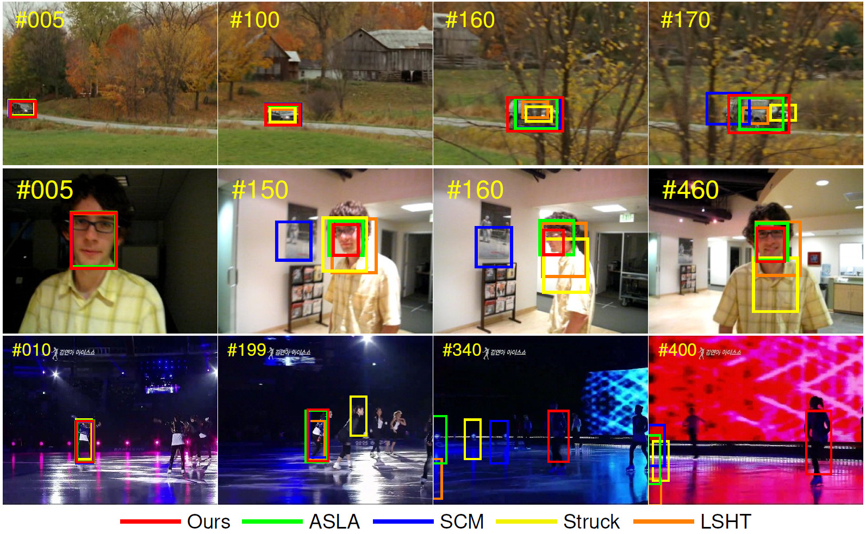
Application: Object Tracking
Given the bounding box for the first frame in a sequence
Identify the bounding box for the each consecutive image in the sequence
Notes:
Performance is measured by the average overlapping between the ground truth bounding box and the generated bounding box

Slide 11
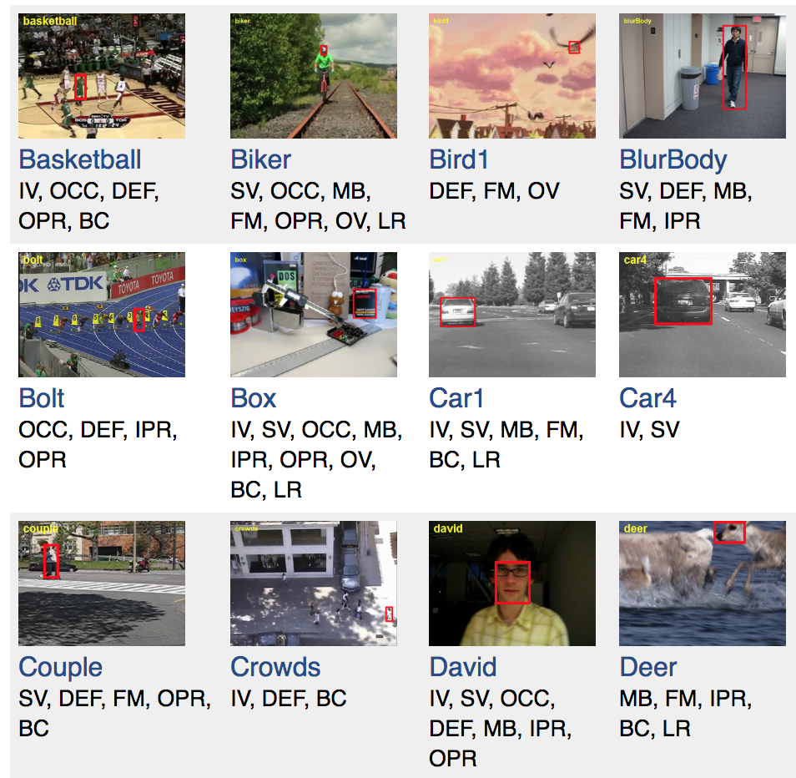
Object Tracking: Benchmarks
Online Object Tracking: A Benchmark^{[1]}
OTB 50
OTB 100
Visual Object Tracking Challenge^{[2]}
VOT 2013
VOT 2014
VOT 2018
[1] Wu, Yi, et al. “Online Object Tracking: A Benchmark,” 2013
[2] Kristan, Matej, at al. “A Novel Performance Evaluation Methodology for Single-Target Trackers,” 2016
Attributes:
Illumination Variation
Scale Variation
Occlusion
Deformation
Motion Blur
Fast Motion
In-Plane Rotation
Out-of-plane Rotation
Out-of-view
Background Clutters
Low Resolution
Notes:
OTB is a popular tracking benchmark that contains 100 fully annotated videos with substantial variations
VOT Challenge maintains their dataset each year by removing the sequence that have been successfully tracked by most trackers and adding new sequences
Both sequence are annotated with attributes:
Illumination variation, scale variation, occlusion, deformation, motion blur, in-plane rotation, etc

Slide 12
Object Tracking: MDNet^{[1]} Framework
Winner of VOT 2015
[1] Nam, Hyeonseob, et al. “Learning Multi-Domain Convolutional Neural Networks for Visual Tracking,” 2015.
Notes:
Winner of VOT 2015
Our network is composed of shared layers and multiple branches of domain-specific layers
domains correspond to individual training sequences and each branch is responsible for binary classification to identify the target in each domain
Network is shallow to keep the network from overfitting
We train the network with respect to each domain iteratively to obtain generic target representations in the shared layers. When tracking a target in a new sequence, we construct a new network by combining the shared layers in the pretrained CNN with a new binary classification layer, which is updated online.
Online tracking is performed by evaluating the candidate windows randomly sampled around the previous target state.
The proposed algorithm illustrates outstanding performance compared with state-of-the-art methods in existing tracking benchmarks.

Slide 13
How to generate samples
BB regression

Slide 14
Result
Table 1: Accuracy after decomposition
 | Before decomp | Decomp conv. | Decomp dense | Decomp all | Decomp rec.*
Before retrain | - | 0.671 | 0.825 | 0.794 | 0.797
After retrain | 0.932 | 0.920 | 0.890 | 0.803 | 0.916
Table 2: Rank selected by VBMF
 | Conv 1 | Conv 2 | Conv 3 | Dense 4 | Dense 5
Original Dim | 3, 96 | 96, 256 | 256, 512 | 512 | 512
VBMF rank | 2, 42 | 76, 205 | 218, 189 | 8 | 1
Recommended Decomposing layers:
All Convolutional layers except the input layer
The first dense layer
Notes:
- Recommend to decompose conv2 to dense 4 since the other two layer’s rank is too low

Slide 15
Object Tracking using Tensor Decomposition API
User specify layers to be decomposed
Automatically pretrain the model using VOT datasets
Decompose the layers using corresponding methodologies
Retrain decomposed model
Test the result on OTB datasets
https://github.com/keithyuck/Object_Tracking/

